Slide 1
Liberty Healthcare Corporation
New Hire Benefits Orientation – California HMO

Slide 2
Benefits Orientation
As a new employee, you are eligible to participate in valuable voluntary benefit plans in addition to your company paid (Core) benefits package (if applicable). Voluntary benefits are conveniently deducted, pretax, from your bi-weekly paycheck.

Slide 3
Benefits Overview- CORE
Core Benefits
Benefit | Provider | Eligibility Date
Group Term Life Insurance and AD&D Group Term Life and AD&D coverage is a company paid benefit. Coverage amounts at 1-times salary with a maximum of $50,000. Long Term Disability (LTD) LTD insurance will pay you 60% of your monthly salary to a maximum of $5,000 if you have been disabled for 180 days. | Hartford | First of the month following 60 days of employment.

Slide 4
Voluntary Benefit Information
Enrollment options are available for employees and eligible dependents
Benefits are available on the 1st of the month following 60 days of employment
Medical, Dental, Vision, Flexible Spending, Dependent Care Account and the 401K are pre-taxed and automatically deducted from your bi-weekly pay check
Enrollments are completed on-line through the ESS
Enrollment deadline: 30 days from hire. If you do not enroll in benefits during your first 30 days from your date of hire, you will have to wait until June 2021 to enroll!

Slide 5
Benefits Overview- Voluntary Benefits
Voluntary Benefits
Benefit | Provider | Eligibility
Medical Liberty offers 3 health plan options - all plans are HMO plans. HSA Value: This plan features a $2,800/$5,600 deductible (in-network). This is a deductible based plan, therefore the deductible must be reach before most services will be covered. This plan also features an integrated Rx plan at $15/$30/20% to $200 HSA 100: This plan features a $2,800/$5,600 deductible (in-network). This is a deductible based plan, therefore the deductible must be reach before most services will be covered. This plan also features an integrated Rx plan. Once the deductible has been reached 100% of coverage is provided, including Rx. Premier: This plan which features a $2,000/$4,000 deductible for certain services (in-network) with $20/$20 copays and $10/$30/20% to $200 Rx. | Kaiser | First of the month following 60 days of employment.
Dental With this Preferred Dentist Program, you get coverage for cleanings, exams, X-rays and more. Vision Vision services included routine eye exams, glasses, contact fittings, evaluations, lenses and more. | United Healthcare
Voluntary Critical Illness Insurance This insurance will pay an employee a lump sum payment when they have been diagnosed with certain serious illnesses. | MetLife

Slide 6
Benefits Overview- Voluntary Benefits
Voluntary Benefits- Continued
Benefit | Provider | Eligibility
Supplement Life Insurance and Accidental Death and Dismemberment (AD&D) Supplemental Life and AD&D coverage provides a financial benefit in the event of death or dismemberment resulting from a covered accident. A variety of coverage options is available. Voluntary Short Term Disability (STD) Voluntary STD provides you with financial security in the event an accident or illness happens and affects your ability to earn money. Hartford offers a coverage amount of 60% of your weekly salary to a maximum of $1,200 per week. | Hartford | First of the month following 60 days of employment.
Flexible Spending Account A Health Flexible Spending Account (or Medical Reimbursement Plan) allows employees to pay for certain expenses with pre-tax dollars, potentially saving the employee Federal income, State income and Social Security taxes on qualifying expenses. | CBIZ

Slide 7
Deductible Schedule Overview
COVERAGE | DEDUCTIBLE SCHEDULE
HSA Value Plan | January - December
HSA 09 Plan | January - December
Premier Plan | January - December
Dental | January – December
Vision | Rolling 12 Months

Slide 8
Benefits Eligibility
In order to cover dependents on your benefits, they must meet the eligibility criteria as outlined below:
  Your legal spouse
  Domestic Partner Spouse
  Your natural, legally adopted or step child
  Domestic Partner Child
  A child for whom the court has issued a QMCSO (Qualified Medical Child Support Order)
  A child for whom you are their legal guardian
  Children must be under the age of 26

Slide 9
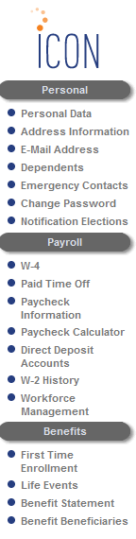
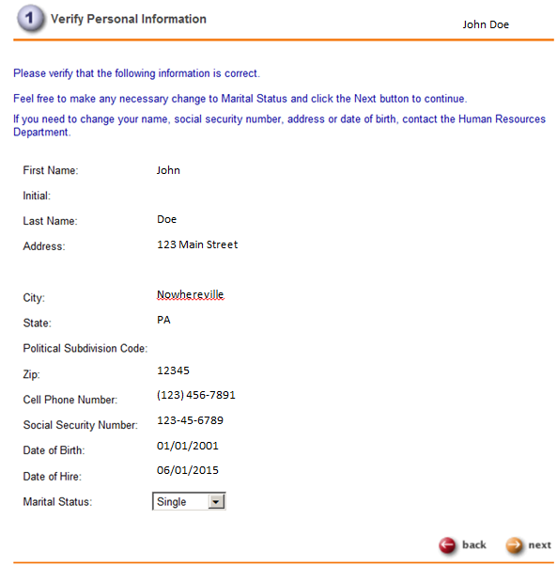
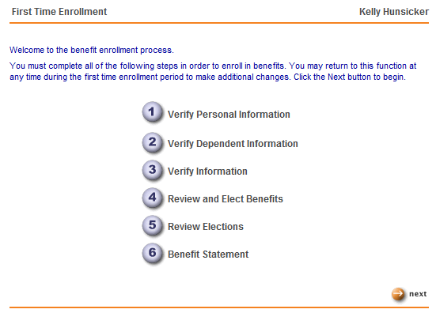
ESS- Benefit Enrollment
Benefit enrollment MUST take place through ESS!!!
Click on “First Time Enrollment
You will need to follow the step-by-step process to complete your enrollment. Press “Next”
Review your personal information. If anything is listed incorrectly, you will need to back out of the benefit enrollment to up update the information under the “Personal” Tab. If all is correct, click “Next”

Slide 10
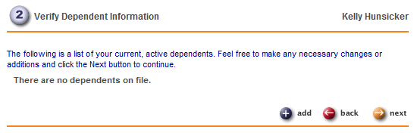
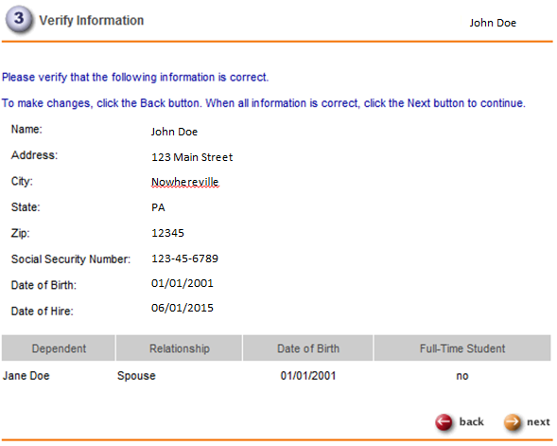
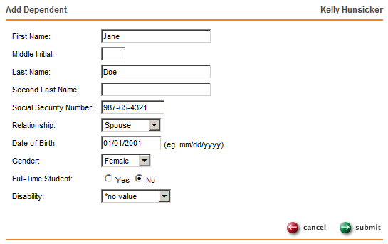
ESS- Benefit Enrollment
Verify dependent information. If you do not have any dependents, click “Next”. If you wish to add a dependent, click “Add”, followed by entering their credentials. Once the dependent information is added, click “Submit”
You will once again be prompted to review and verify all your information, and your dependent information is correct, click “Next”

Slide 11
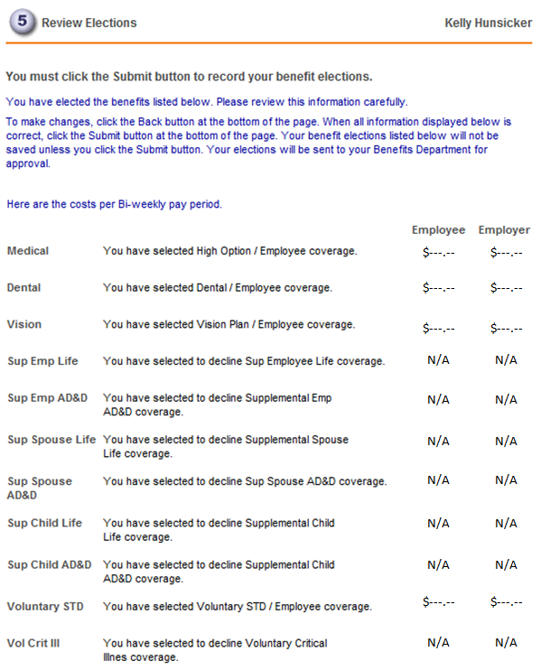
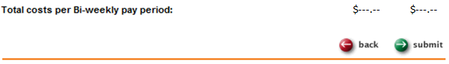
ESS- Benefit Enrollment
Select your benefits by checking the box to the right of the benefit option. Be sure to pay attention to the icons next to some of the benefits. Further action might be required to complete the enrollment. Once all the benefit options either have an election or declination, click “Next”. If you are declining Medical benefits, you will need to email the HR Department at HR@libertyhealth.com to provide your declination reason.
The benefit statement is a summary of the benefits you elected. If all is correct, click “Submit”. Once Submitted, a popup box will appear letting you know that your benefits were successfully submitted. Click, “OK” and no further action is necessary
If you do not want to enroll in benefits, you have to actively decline your benefit options in ESS!!!
Dependents
Beneficiaries
Coverage
Contribution

Slide 12
401k- Retirement Savings Plan
401k- Retirement Savings Plan
Benefit | Provider | Eligibility Date
401k Retirement Savings Plan Automatic enrollment of 3% of your salary from pre-tax dollars to save for retirement. | Fidelity | Automatic enrollment, first of the month following 90 days of employment.
Refer to the New Hire Benefits Informational video found on ESS for additional information

Slide 13
Employee Assistance Program (EAP)
Available to family members, including spouse and dependents
Includes three face-to-face emotional or work-life counseling sessions, per occurrence per year
1-800-96-HELPS
available 24/7
or
www.guidanceresources.com
- Company/organization field: HLF902
- Company name field: abili

Slide 14
EAP – Services Offered
ABILITY ASSIST COUNCELING SERVICES
Emotional or work-life counseling | Job pressure Relationship/marital conflicts Stress, anxiety and depression Work/school disagreements Substance abuse Child and elder care referral services
Financial information and resources | Managing a budget Retirement Saving for college Getting out of debt Tax questions
Legal support and resources | Debt and bankruptcy Guardianship Divorce Buying a home Power of attorney
HealthChampion | One-on-one review of your health concerns Preparation for upcoming doctor’s visits/lab work/test/surgeries Answers regarding diagnosis and treatment options Coordination with appropriate health care plan providers(s) An easy-to-understand explanation of your benefits – what’s covered and what’s not Cost estimation for covered/non-covered treatment Guidance on claims and billing issues Fee/payment plan negotiation

Slide 15
Questions?
If you need further assistance or have additional questions, please feel free to contact a member of the HR Department at 1-800-331-7122 or via e-mail at HR@libertyhealth.com

